Slide 1
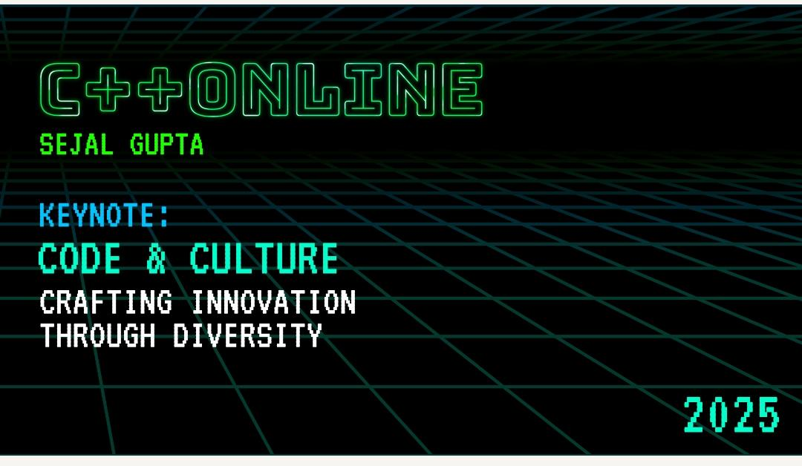

Slide 2



CODE AND CULTURE
How would you feel if you're lost in a foreign land and can’t make sense of sign boards?

Slide 3
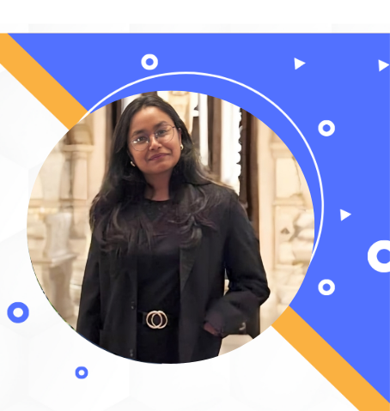

CODE & CULTURE
Crafting Innovation Through Diversity
SEJAL GUPTA (She/Her)
Software Developer, India
Founder @ WIT++: Women in Tech
Enthusiastic about Green Computing
Tea Sommelier☕;Blogger📝

Slide 4
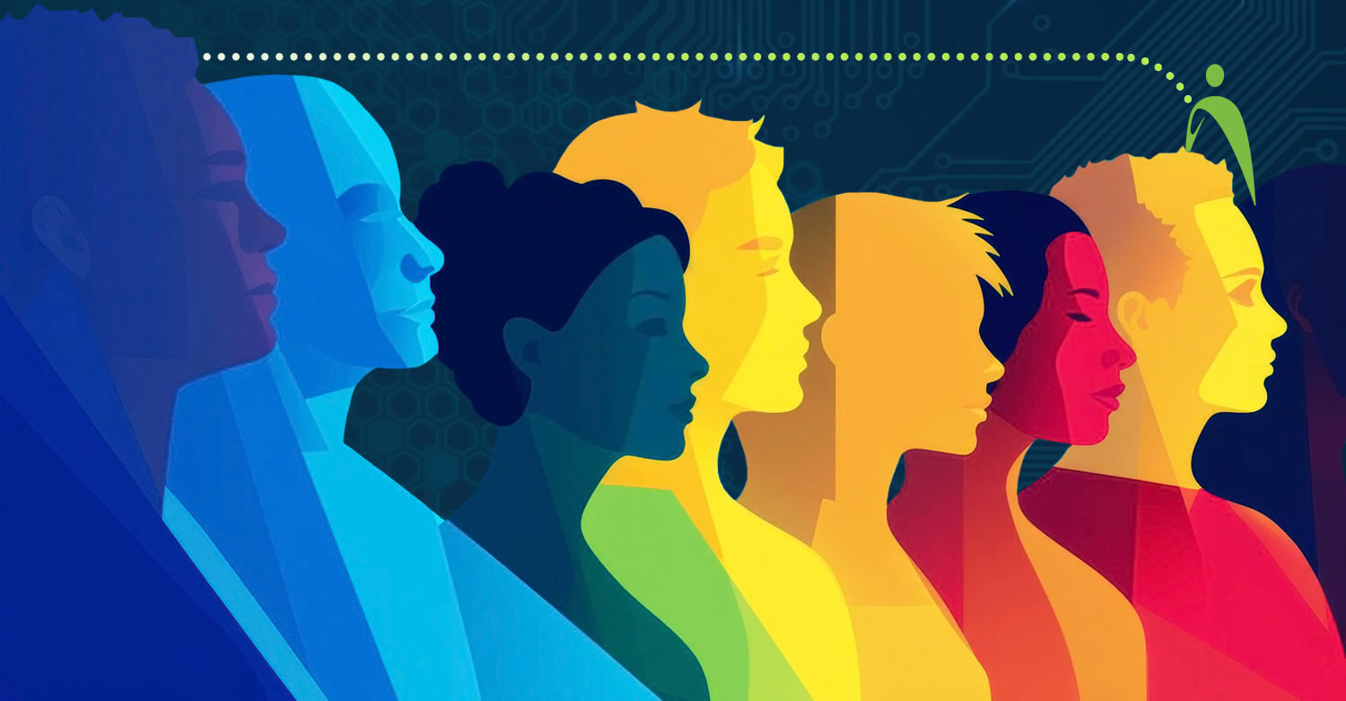
Disclaimer
The thoughts and views expressed solely represent my opinion. The content in no way represents the views and opinions of the people, institutions, or organization that I may or may not be associated with in professional and personal capacity, unless explicitly stated.

Slide 5






Slide 6
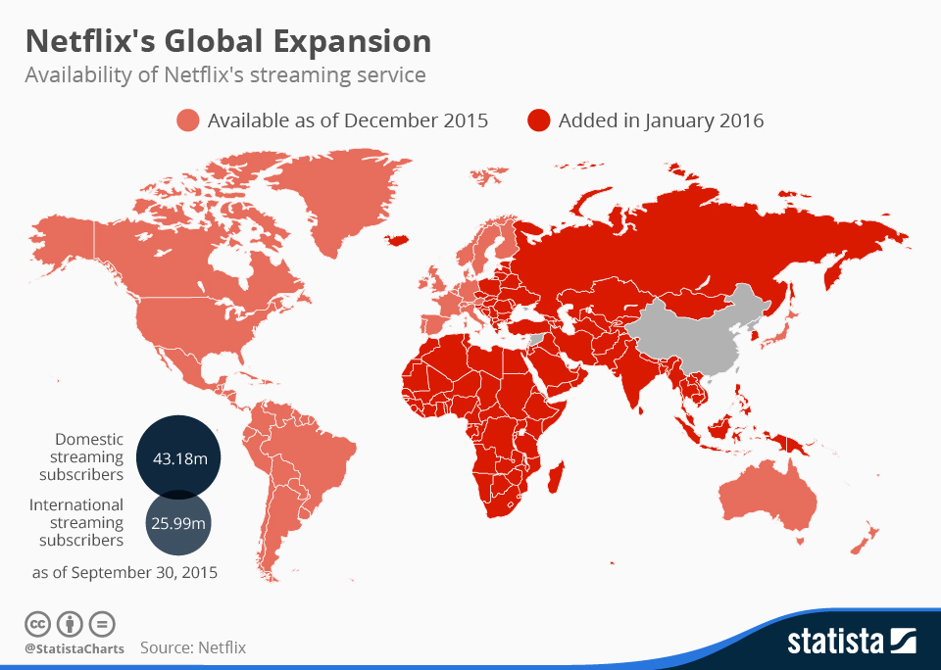
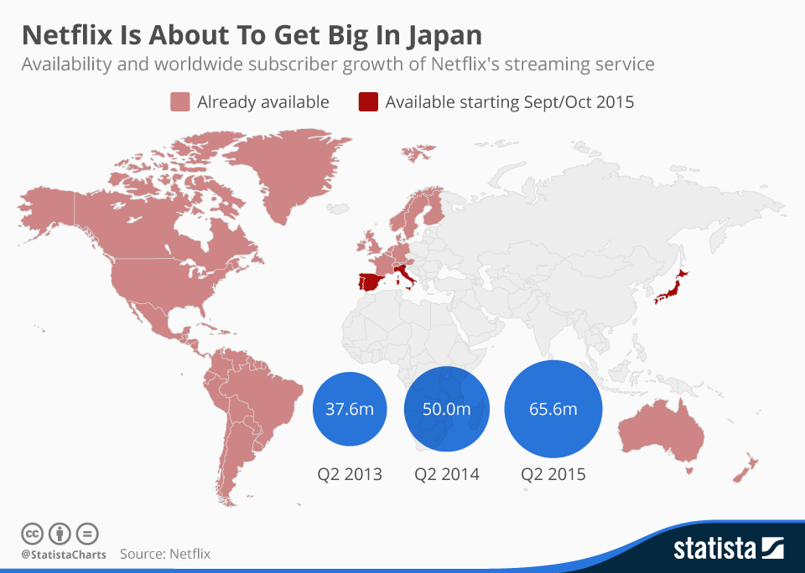
Diverse stories connect the world
Solution^{[1]}: Consciously hired diverse talent
Results^{[1]}:
$15 billion (~30%) Increase in Revenue
Gained 47.3 Million international subs in 2 years

Slide 7
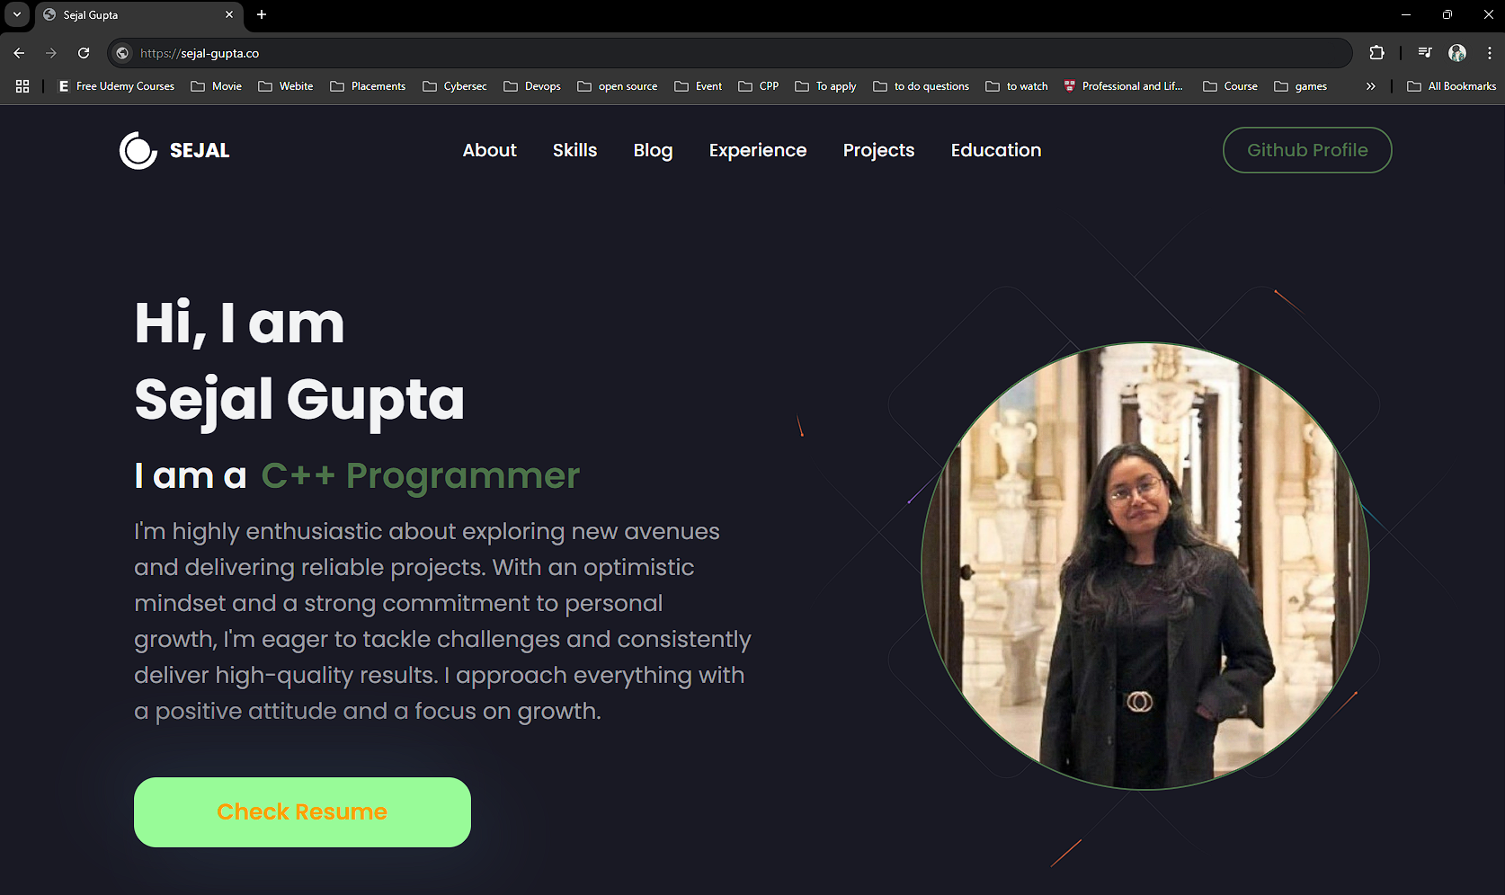
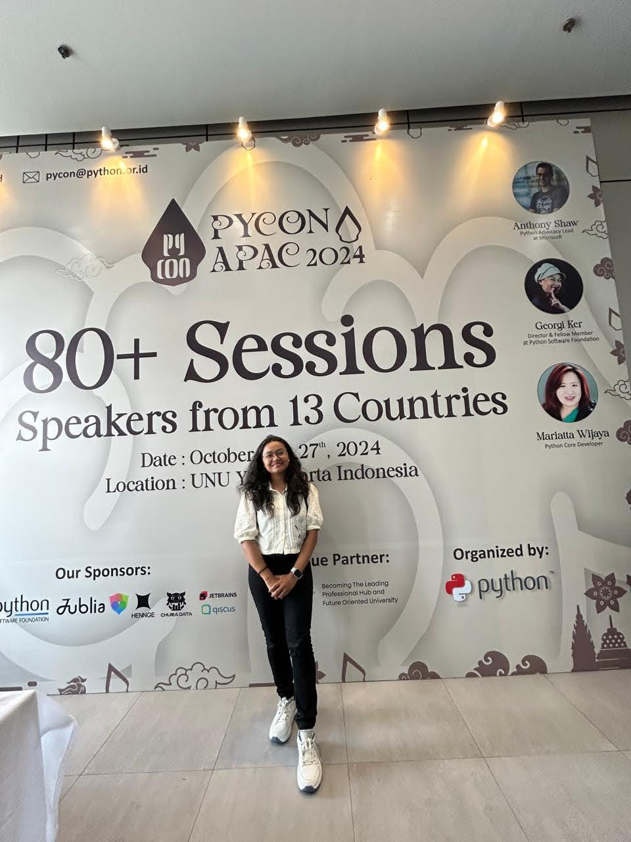

Slide 8
CODE AND CULTURE
8% of men = ~322 million men are colorblind^{[3]}
0.5% of women = ~20 million women are colorblind^{[3]}
28% = ~2.2 billion globally, live with some form of vision impairment^{[3]}
“An estimated 1.3 billion people, i.e. 16% of the global population, currently experience significant form of disability” ^{[2]}

Slide 9

CODE AND CULTURE
What is Inclusion?
Treating everyone the same is the best way to be inclusive.

Slide 10
CODE AND CULTURE
Inclusion
Geographic Inclusion
Linguistic Inclusion
Neurodiversity
Equity
Accessibility
Diversity
Economic Inclusion
Cultural Inclusion
Notes:
There are many aspects of inclusion. equity, belonging, cultural competency, linguistic inclusion, economic inclusion, neurodiversity, geographic inclusion.. to name a few. I’ll focus on two of these flavors: accessbility and diversity

Slide 11
CODE AND CULTURE
Why is Inclusion in Tech Important?
Notes:
WHY I SHOULD CARE AS A DEVELOPER

Slide 12
CODE AND CULTURE
Why Should I Care About Inclusion as a Developer?
Notes:
WHY I SHOULD CARE AS A DEVELOPER

Slide 13
CODE AND CULTURE
Women hold 25% of computing jobs, despite representing 49.6% globally^{[4]}
Less than 5% of tech workers globally openly identify as LGBTQIA+ ^{[5]}
Black professionals hold 2% of tech jobs, despite making up 6-10% of population in UK, France^{[6]}
1–3% of global tech workers disclose disabilities compared to 16% of the global population living with disabilities^{[2],[7]}
Notes:
“Let’s build a future where everyone has a seat at the table."
Speaker notes:
"According to a 2023 report by the Bureau of Labor Statistics:
Only 26% of computing-related jobs are held by women.
Black professionals hold just 7% of tech jobs, despite making up 13% of the U.S. population.
Latinx professionals hold only 8% of tech jobs, while representing 18% of the population.
And for individuals with disabilities, representation drops to less than 5% in the tech workforce."
Connecting the Dots:
"These stats aren’t just numbers—they’re missed opportunities. If we’re building tech for everyone, shouldn’t our teams look like everyone?"
Setting the Stage:
"Today, we’re talking about why diversity in software engineering isn’t just nice to have—it’s a must.—it’s a necessity for innovation, growth, and creating products that truly meet the needs of everyone. We’ll explore the challenges we face, the progress being made, and most importantly, what each of us can do to build a more inclusive future in tech."

Slide 14
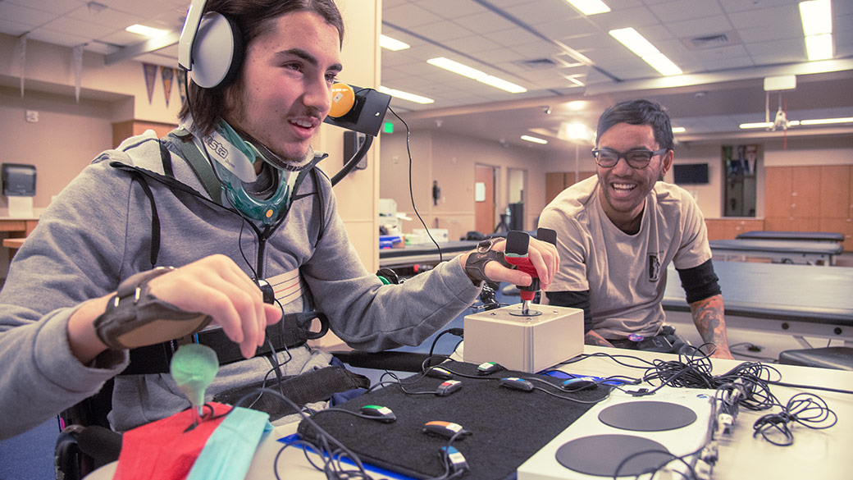

Case Study: Inclusive Design for Accessibility
Notes:
Challenge: Tech products often exclude people with disabilities.
Solution: Diverse teams, including engineers with disabilities, designed the Xbox Adaptive Controller.
Outcome: A groundbreaking product that empowers gamers with limited mobility.
Let’s start with Microsoft—a company that’s leading the way in inclusive design.
Here’s the challenge they faced: Many tech products weren’t designed with people with disabilities in mind. This meant that a significant portion of the population was being left out.
So, what did Microsoft do? They formed diverse teams, including engineers with disabilities, to tackle this problem head-on. One of their most iconic innovations is the Xbox Adaptive Controller.
This controller was designed specifically for gamers with limited mobility. It features customizable inputs, compatibility with external devices, and a user-friendly design.
The result? A groundbreaking product that’s been praised for its inclusivity and innovation.
The key takeaway here is simple: Diverse teams create products that work for everyone. By including people with disabilities in the design process, Microsoft didn’t just solve a problem—they set a new standard for accessibility in tech." A diverse team considers edge cases that a homogeneous group might overlook, leading to products that cater to a wider audience.

Slide 15
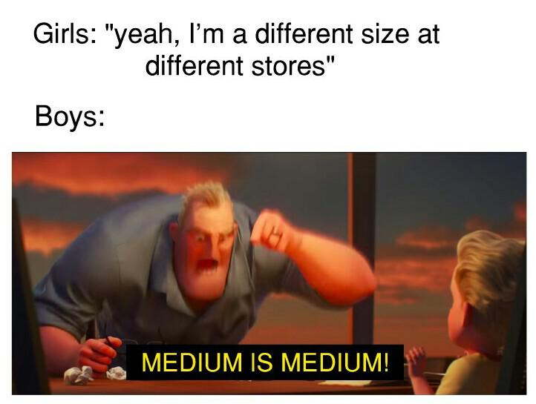

Slide 16

Case Study: YouTube’s Auto-Muting Algorithm
YouTube’s auto-detection for silent videos mistakenly muted sign language videos, assuming they contained “no content.”
Notes:
Challenge: Tech products often exclude people with disabilities.
Solution: Diverse teams, including engineers with disabilities, designed the Xbox Adaptive Controller.
Outcome: A groundbreaking product that empowers gamers with limited mobility.
Let’s start with Microsoft—a company that’s leading the way in inclusive design.
Here’s the challenge they faced: Many tech products weren’t designed with people with disabilities in mind. This meant that a significant portion of the population was being left out.
So, what did Microsoft do? They formed diverse teams, including engineers with disabilities, to tackle this problem head-on. One of their most iconic innovations is the Xbox Adaptive Controller.
This controller was designed specifically for gamers with limited mobility. It features customizable inputs, compatibility with external devices, and a user-friendly design.
The result? A groundbreaking product that’s been praised for its inclusivity and innovation.
The key takeaway here is simple: Diverse teams create products that work for everyone. By including people with disabilities in the design process, Microsoft didn’t just solve a problem—they set a new standard for accessibility in tech." A diverse team considers edge cases that a homogeneous group might overlook, leading to products that cater to a wider audience.

Slide 18

CODE AND CULTURE
Feedback Form
Pronouns
First Name
Last Name
Date of Birth
Phone No.
### ### ###
Security Check
Type the text here
Next

Slide 19

CODE AND CULTURE
Feedback Form
Pronouns
First Name
**First Name too short
Last Name
**special characters not allowed
Li
Chan Mei
He/His
She/Her
Date of Birth
Phone No.
**exchange code cannot be empty
03/02/1999
+91
### ### ###
Security Check
Type the text here
Next
Notes:
it doesn’t deliver information what the form is about
pronouns are not sufficient.
first name last name. some people have legal name and preferred name. not considered.
by the end of this extremely alienating form, the user is still not able to fill the feedback.

Slide 20
Mitigating Bias
Innovation
&
Diverse Perspective
SEO-friendly
A11y Overlap
More Traffic,
Broader Adoption,
Higher Engagement
Broader Functionality,
Competitive Edge
Notes:
How can i bring inclusion in tech?

Slide 21
CODE AND CULTURE
Global disability market represents $8 trillion^{[8]}
19% Increase in Revenue^{[9]}
78% millennials and Gen z population prefer inclusive brands^{[10]}
Inclusive workplaces boost performance by 56%^{[11]}
Notes:
in a more broader picture, ...
Economic Impact
Companies with above-average diversity in leadership outperform their peers by 33% in profitability. (Source: McKinsey & Company)
Inclusive teams make better business decisions 87% of the time. (Source: Cloverpop)
If global tech companies prioritized gender parity, it could add $12 trillion to the global economy by 2025. (Source: McKinsey Global Institute)
2. Talent and Innovation
Companies with diverse teams see a 19% increase in innovation revenue compared to less diverse ones. (Source: BCG)
Diverse teams are 1.7 times more likely to capture new markets. (Source: Harvard Business Review)
The tech industry faces a talent shortage of 85 million people by 2030, and diverse hiring can help bridge this gap. (Source: Korn Ferry)
3. Accessibility and Market Reach
Over 1 billion people live with some form of disability globally, representing a market worth $8 trillion. (Source: WHO, Return on Disability)
70% of online businesses that implemented accessibility features saw an increase in customer satisfaction and engagement. (Source: Forrester Research)
4. Consumer Expectations
64% of consumers are more likely to support brands that demonstrate a commitment to diversity and inclusion. (Source: Accenture)
78% of millennials say they’re more likely to buy from companies whose values align with theirs, including inclusivity. (Source: Deloitte)
5. Workplace Retention and Productivity
Employees who feel included are 3 times more likely to stay at their jobs. (Source: Deloitte)
Inclusive workplaces boost employee performance by 56% and collaboration by 42%. (Source: Deloitte)

Slide 22
CODE AND CULTURE
How can I bring Inclusion through my Code?
#include <inclusion.h>
Notes:
how can i add a layer of inclusion in tech?
Bing mindful, proactive measures, ARIA testing tools.

Slide 23
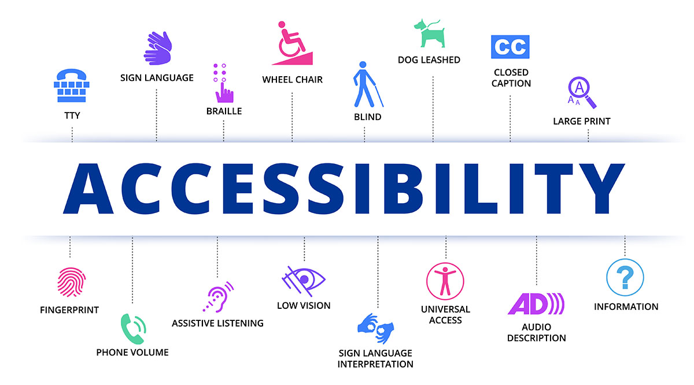

Slide 24
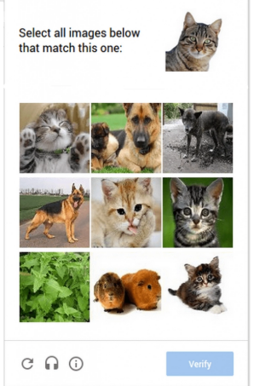
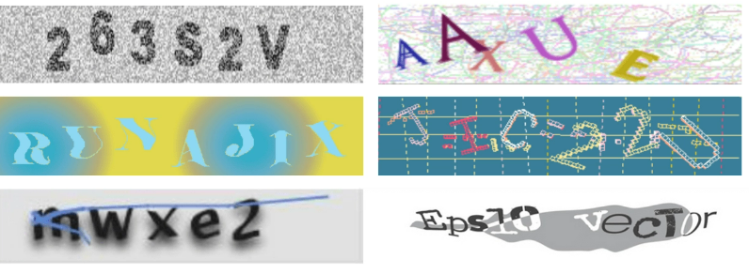
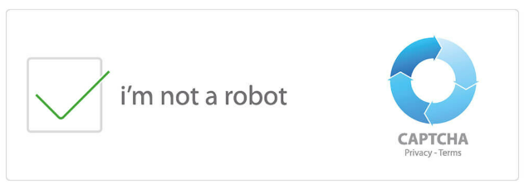
Implementing Authentication Security Protocols
Notes:
We all have interacted with security protocols in some way or the other. This particular example on the screen is to verify replay or impersonation attacks in general and we go with challenge response protocols like Captchas.
According to the World Health Organization (WHO), over 2.2 billion people worldwide have hearing loss, which is about 25% of the global population.

Slide 25
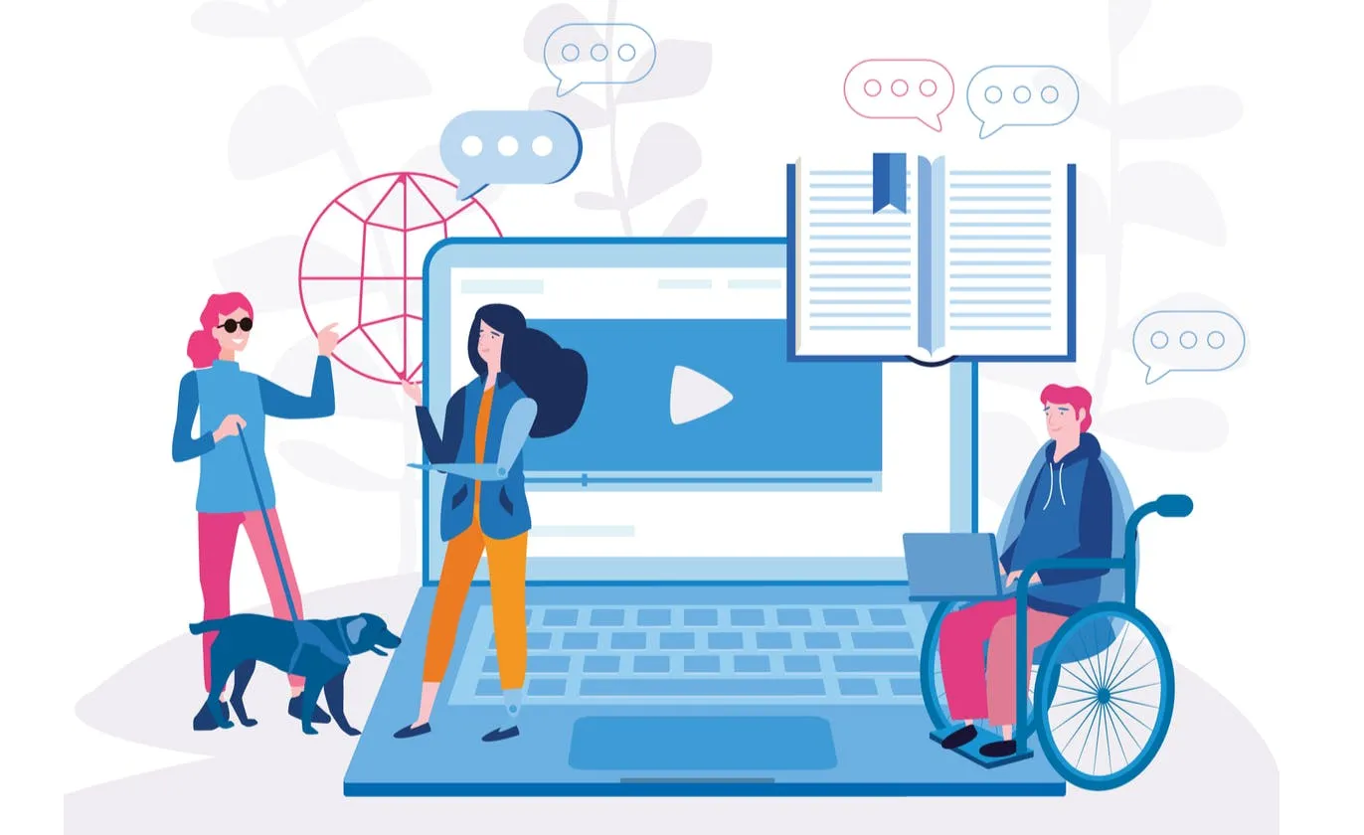
CODE AND CULTURE
Make Tech Products Keyboard Navigable
Provide text alternatives for media content
Incorporate assistive tech tools, like captions, text-to-speech, voice recognition, if needed.
Web Content Accessibility Guidelines (WCAG)
W3C Web Accessibility Initiative

Slide 26
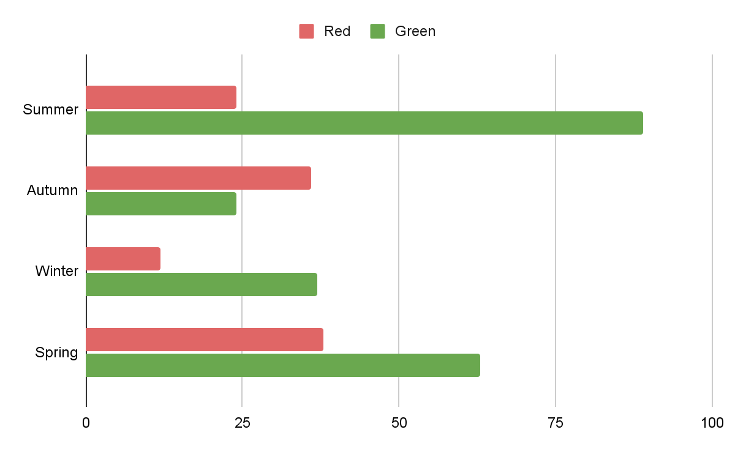
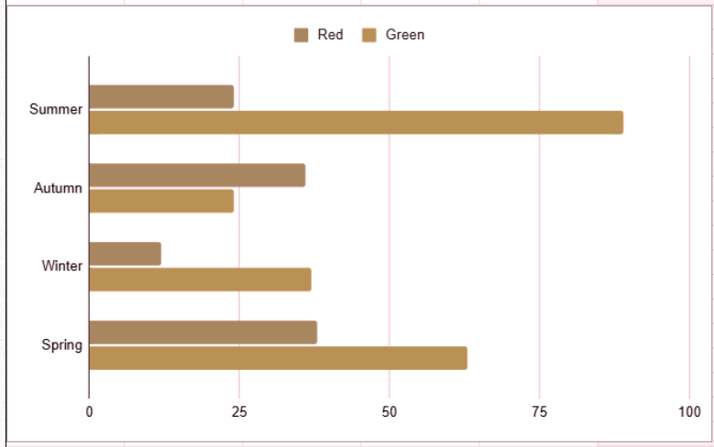
CODE AND CULTURE
Accessible Color Contrast
Bar chart to normal eyes
Same chart to Green-Red color blindness

Slide 27
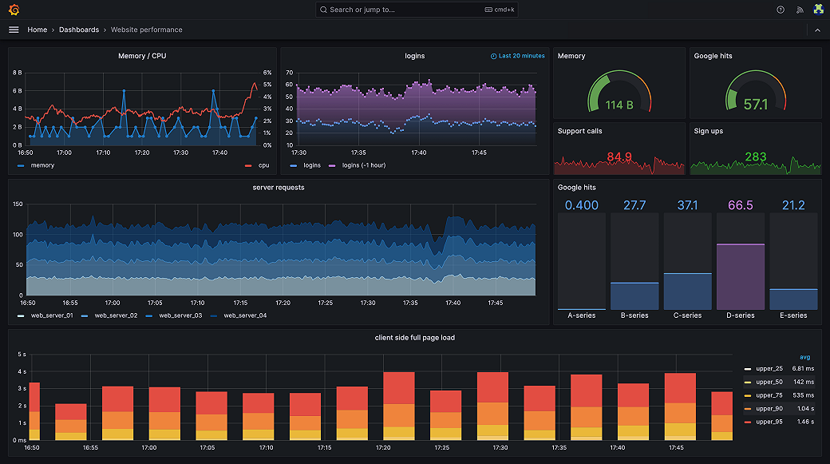

Slide 28
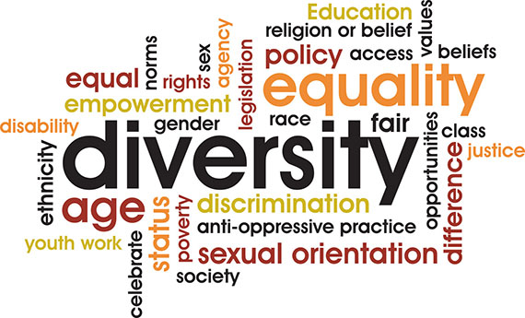

Slide 29
BIAS IN TECH PRODUCTS
Using training/testing with cultural bias.
Systemic barriers
Exclusionary Product Designs

Slide 30

Case Study: Snapchat’s Filter Controversy
A culturally diverse team helps avoid missteps that alienate or offend global users.

Slide 31
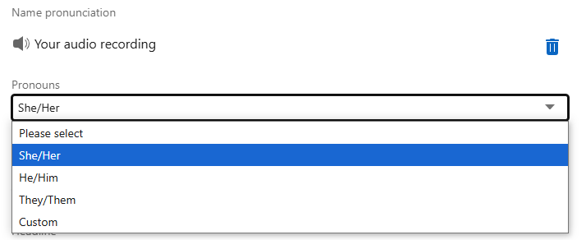

Case Study: Addition of They/Them Pronoun
“Clearly members want to feel empowered about how they self-identify" Bef Ayenew, Head of Engineering for Identity

Slide 32
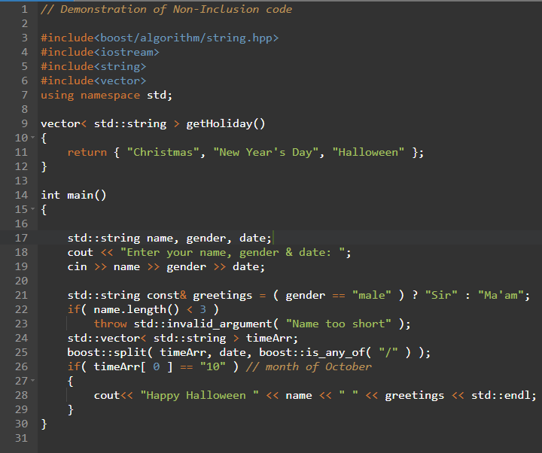
Cultural Bias in Code
Neglecting other cultural holidays and traditions.
Neglecting non-binary users
Alienating on ethnicity
Assuming Western Date formats
Notes:
let me give you a very simple, honest coding mistake

Slide 33
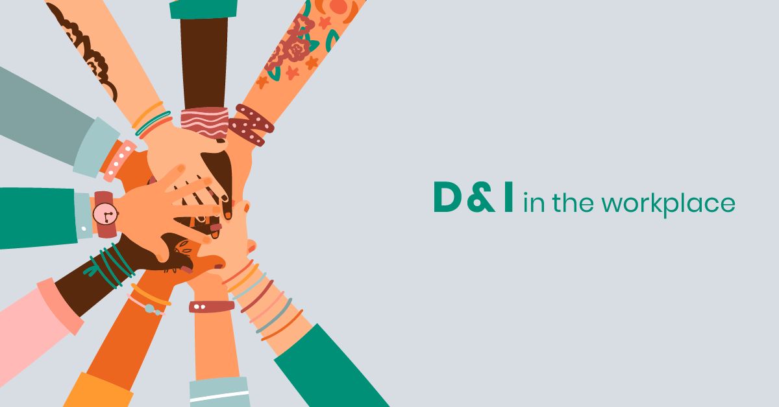

Slide 34
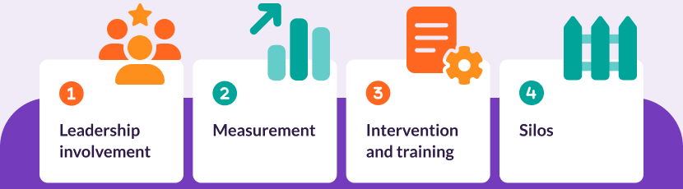
Diversity Beyond Numbers
Hiring Mindfully
Know your Audience
Respect &
belonging
Investing in D&I

Slide 35
Diversity Beyond Numbers
“When we prioritize diversity, we’re not just building better technology; we’re building a more equitable future”

Slide 36
Diversity Beyond Numbers
“Inclusion is not an option - it’s essential for building tech that truly serves all.”

Slide 37
CODE AND CULTURE
[1] Sage Journal: https://journals.sagepub.com/doi/10.1177/17496020211037259
[2] WHO Report: https://www.who.int/health-topics/disability
[3] UNDRR 2023 Survey: https://www.undrr.org/report/2023-gobal-survey-report-on-persons-with-disabilities-and-disasters
[4] UNSECO 2023: https://www.unesco.org/en/articles/international-womens-day-new-factsheet-highlights-gender-disparities-innovation-and-technology
[5] Out Now Global: https://www.outnowconsulting.com/lgbt2020
[6] Eurostat: https://ec.europa.eu/eurostat
[7] ILO, 2023: https://www.ilo.org/publications/flagship-reports/world-employment-and-social-outlook-trends-2023

Slide 38
CODE AND CULTURE
[8] World Economic Forum: https://www.weforum.org/
[9] BCG Study: https://www.bcg.com/publications/2018/how-diverse-leadership-teams-boost-innovation
[10] Deloitte Survey:https://www.deloitte.com/global/en/issues/work/content/genz-millennialsurvey.html
[11] McKinsey & Company: https://www.mckinsey.com/featured-insights/diversity-and-inclusion/diversity-wins-how-inclusion-matters

Slide 39
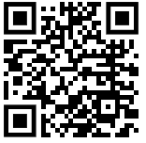
Let’s Gather Town!
Connect with me on LinkedIn: https://www.linkedin.com/in/sejal-gupta-she-her/
Or Use this QR Code

